Slide 1
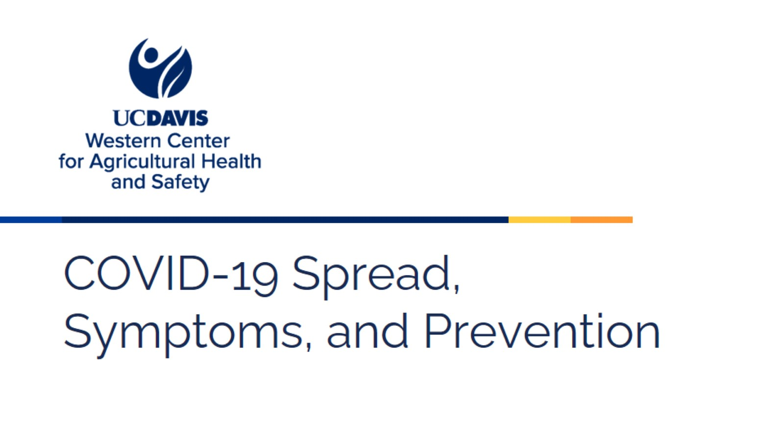
COVID-19 Spread, Symptoms, and Prevention
Notes:
Today we are going to talk about COVID-19, how it spreads, the common symptoms, and how to prevent exposure to the virus.

Slide 2
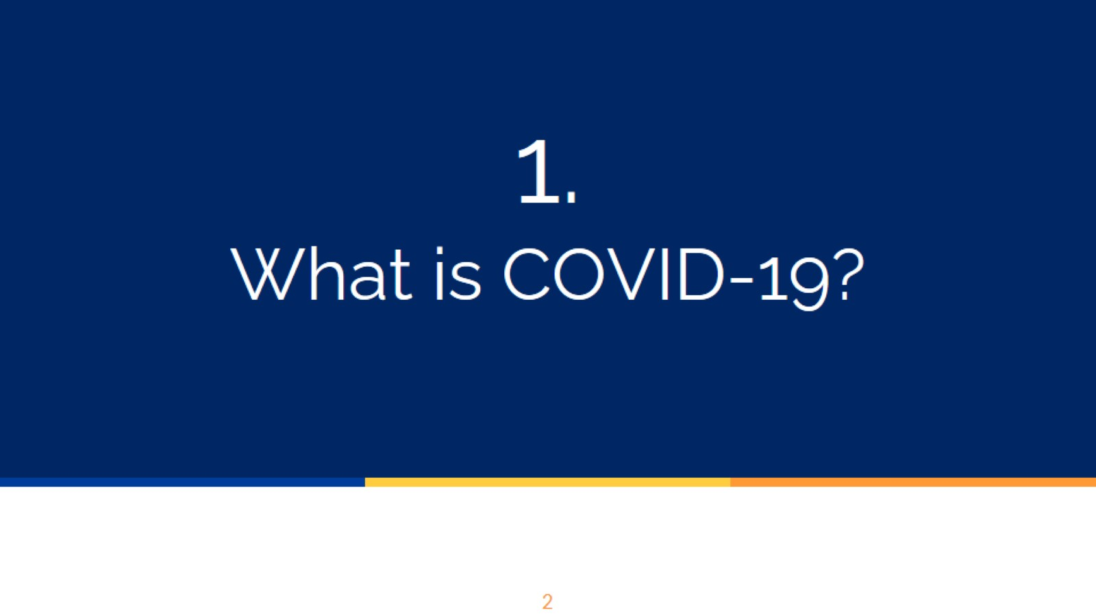
1.
What is COVID-19?
Notes:
What is COVID-19?

Slide 3
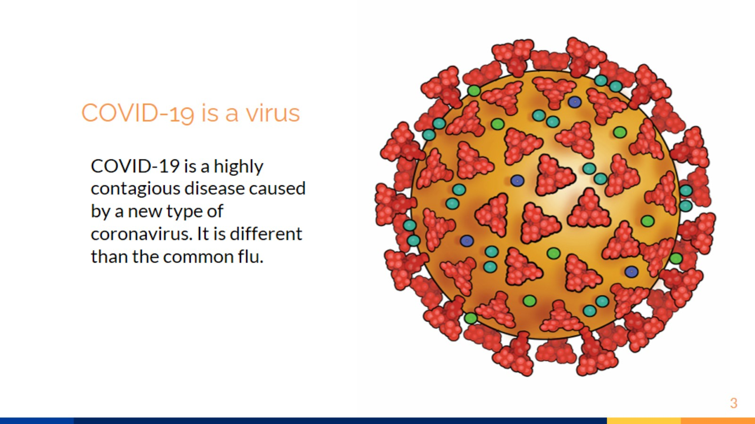
COVID-19 is a virus
Notes:
What is COVID-19?
COVID-19 is a virus. Viruses are very small germs. We cannot see viruses with the naked eye and would need a very powerful microscope to see them. Viruses are so small that millions of them could fit into a grain of salt.
Coronavirus disease, an infectious disease caused by the severe acute respiratory syndrome coronavirus 2 (SARS-CoV-2).
COVID-19 is a new disease and is different than the common flu. Both can cause serious illness, even one that leads to hospitalization or death. Although we’re still learning about COVID-19, recent studies confirm that COVID-19 is more deadly than the seasonal flu.

Slide 4
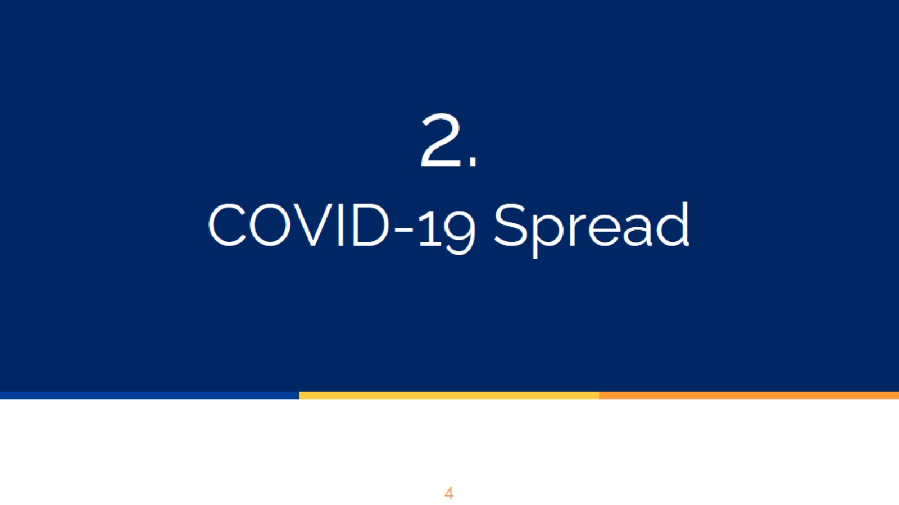
2.
COVID-19 Spread
Notes:
Now we are going to talk about how COVID-19 spreads.

Slide 5
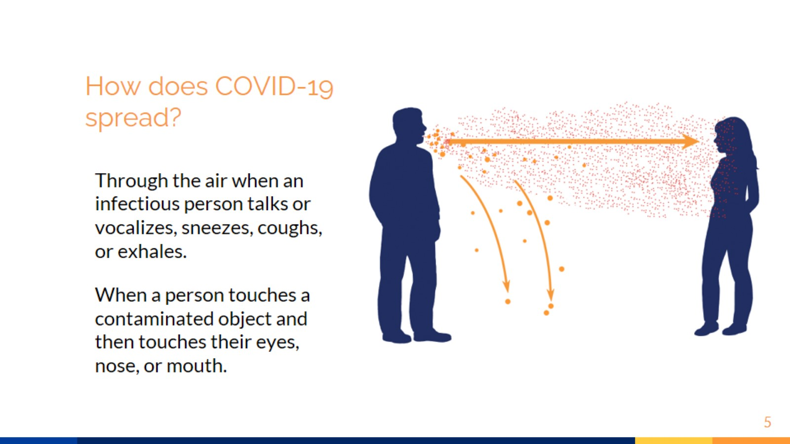
How does COVID-19 spread?
Notes:
How does COVID-19 spread?
All people, when we breathe, inhale (pull in) and exhale (push out) air that has been in our lungs. When that air comes out, it carries very small droplets, which could carry the virus if the person is infected with COVID-19.
Have you noticed that when it is very cold, a cloud-like vapor forms when we blow the air out, or when we speak?
Those are the droplets that come out as part of the breath all the time. When it is cold, we notice them, because the air in the lungs is warmer than the cold air.
The droplets that are exhaled can be of different sizes. The biggest ones are heavier and fall to the ground quickly. The smaller ones are lighter and can hang in the air for a while.
To see how the smallest droplets move suspended in the air for some time, think about what happens when someone is roasting hot peppers in the kitchen and the smell reaches other parts of the house. This is because the particles with the smell of the peppers have moved through the air.
In the case of COVID-19, if a healthy person breathes in droplets that carry the virus, the virus could enter their body and infect them.

Slide 6
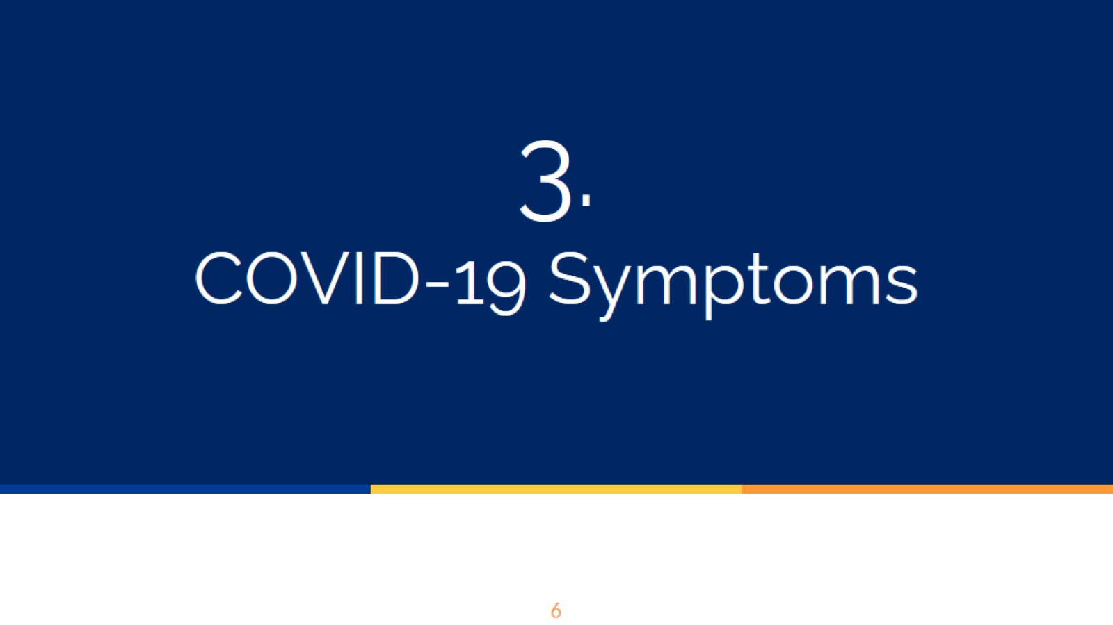
3.
COVID-19 Symptoms
Notes:
Now we are going to talk about common COVID-19 symptoms.

Slide 7
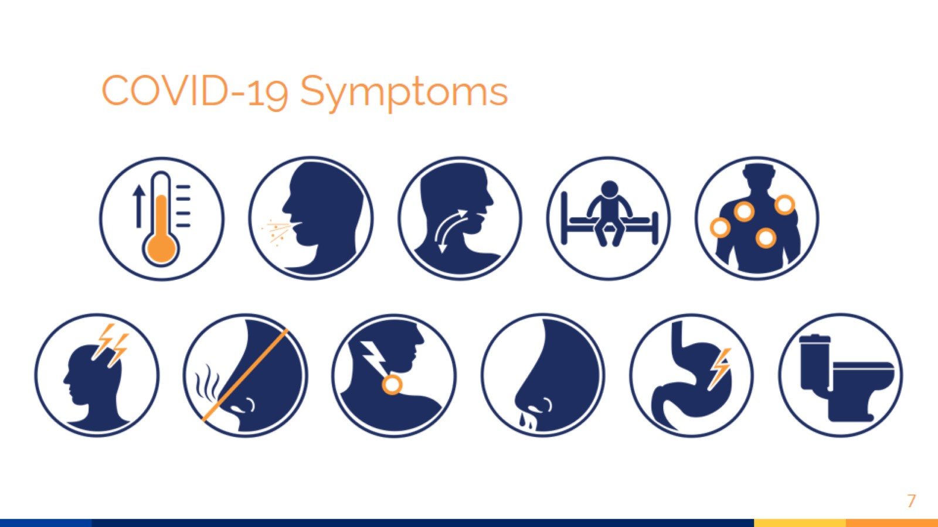
COVID-19 Symptoms
Notes:
COVID-19 is highly contagious and affects people differently. Among the differences is that there are people who have symptoms and others who never develop symptoms (known as asymptomatic). People with and without symptoms are both contagious and can spread the virus to others.
In some infected people, symptoms can appear 2 to 14 days after exposure to the virus.
Common Symptoms of COVID-19:
Fever or chills
Cough
Shortness of breath or difficulty breathing
Fatigue
Muscle or body aches
Headache
New loss of smell or taste
Sore throat
Congestion or runny nose
Nausea or vomiting
Diarrhea

Slide 8
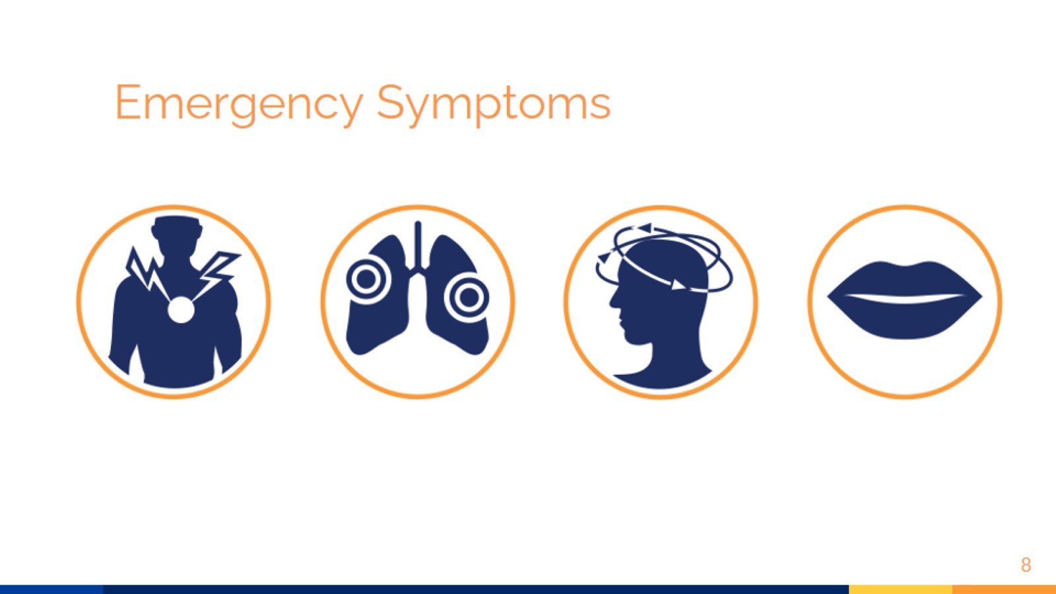
Emergency Symptoms
Notes:
The following symptoms are considered serious and could be life threatening. If you have them, call 9-1-1 immediately:
Trouble breathing
Persistent pain or pressure in the chest
New confusion
Inability to wake or stay awake
Bluish lips or face

Slide 9

Who gets sick?
Notes:
What kind of people could get sick?

Slide 10
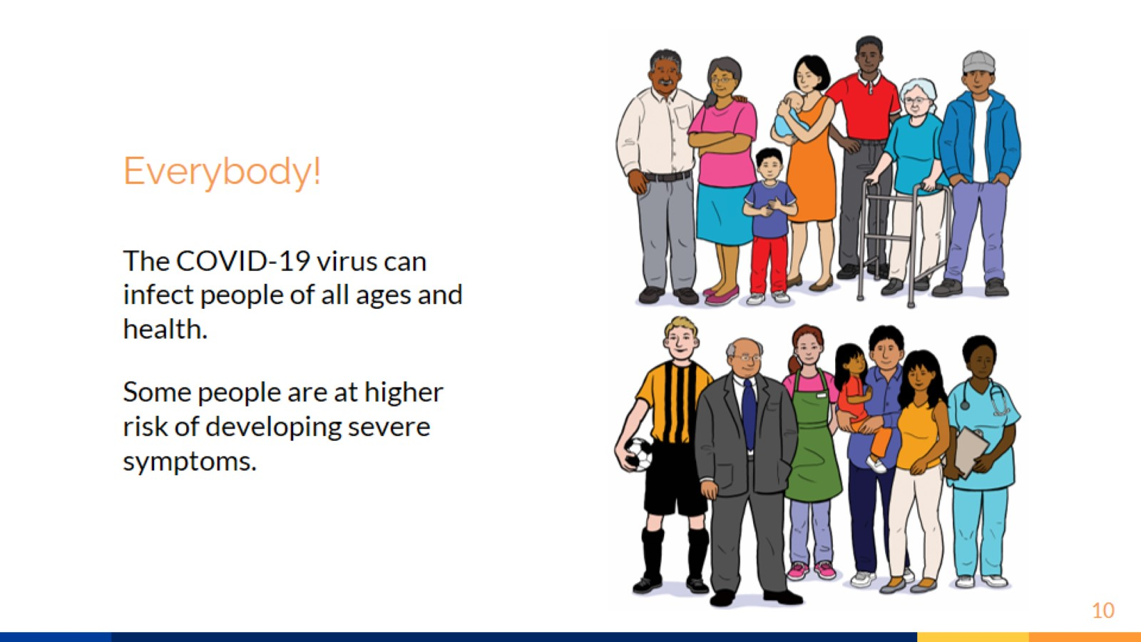
Everybody!
Notes:
Who can get sick with COVID-19?
Everybody! The COVID-19 virus can infect people of all ages and health. Young, healthy people have been known to become seriously ill from COVID-19 and others (even older people) have recovered.
However, there are people who are generally at higher risk of developing severe symptoms. People with underlying medical conditions, such as heart conditions, cancers, those with compromised immune systems, and other chronic illnesses are at increased risk for severe illness. Other factors like being overweight, smoking, having asthma, or being pregnant may also increase risk.
The reason the risk is higher for these people is because their body's defenses are fighting the conditions that affect them, and COVID-19 presents an additional fight.
If you have questions about a specific condition and how it may affect your risk, ask a healthcare professional.

Slide 11
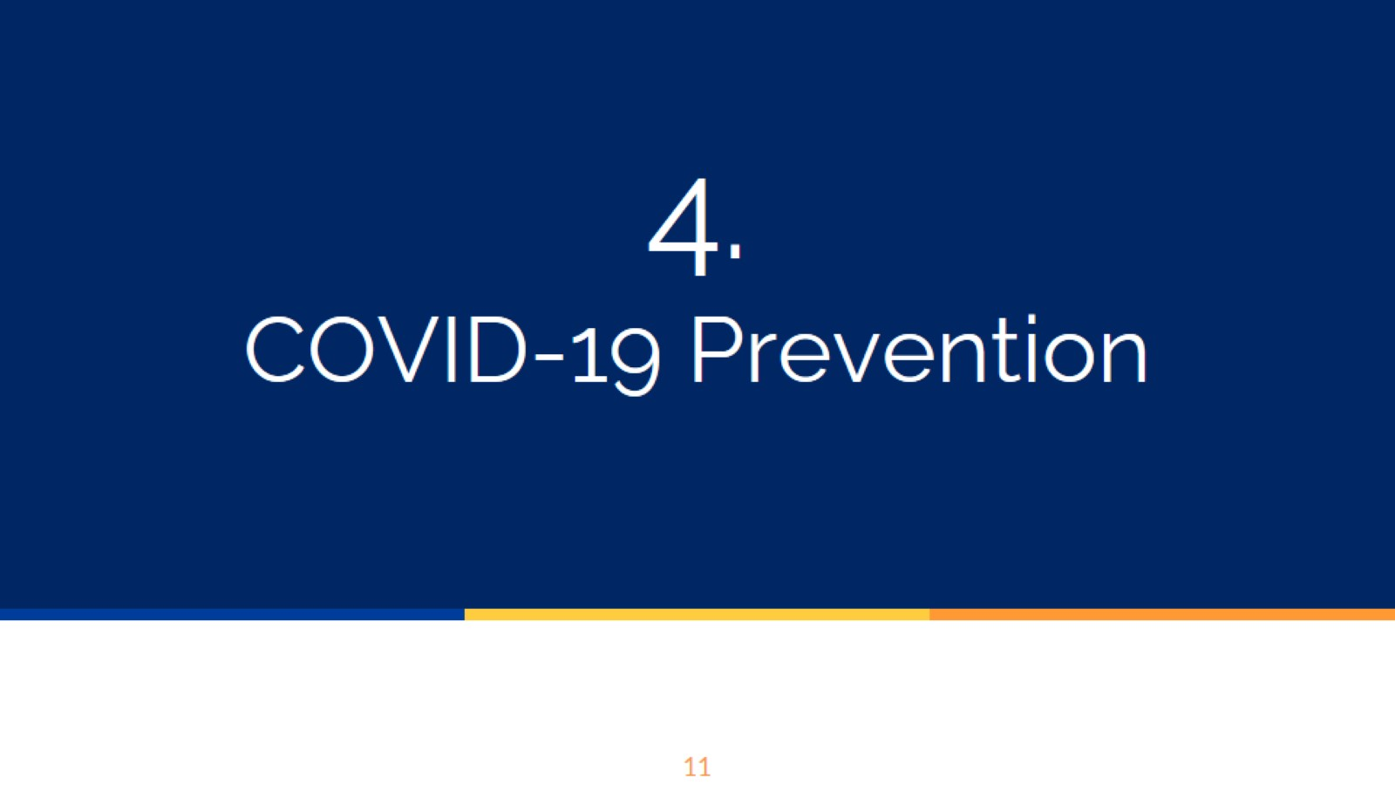
4.
COVID-19 Prevention
Notes:
Now we are going to talk about how you can prevent being exposed to the virus.

Slide 12
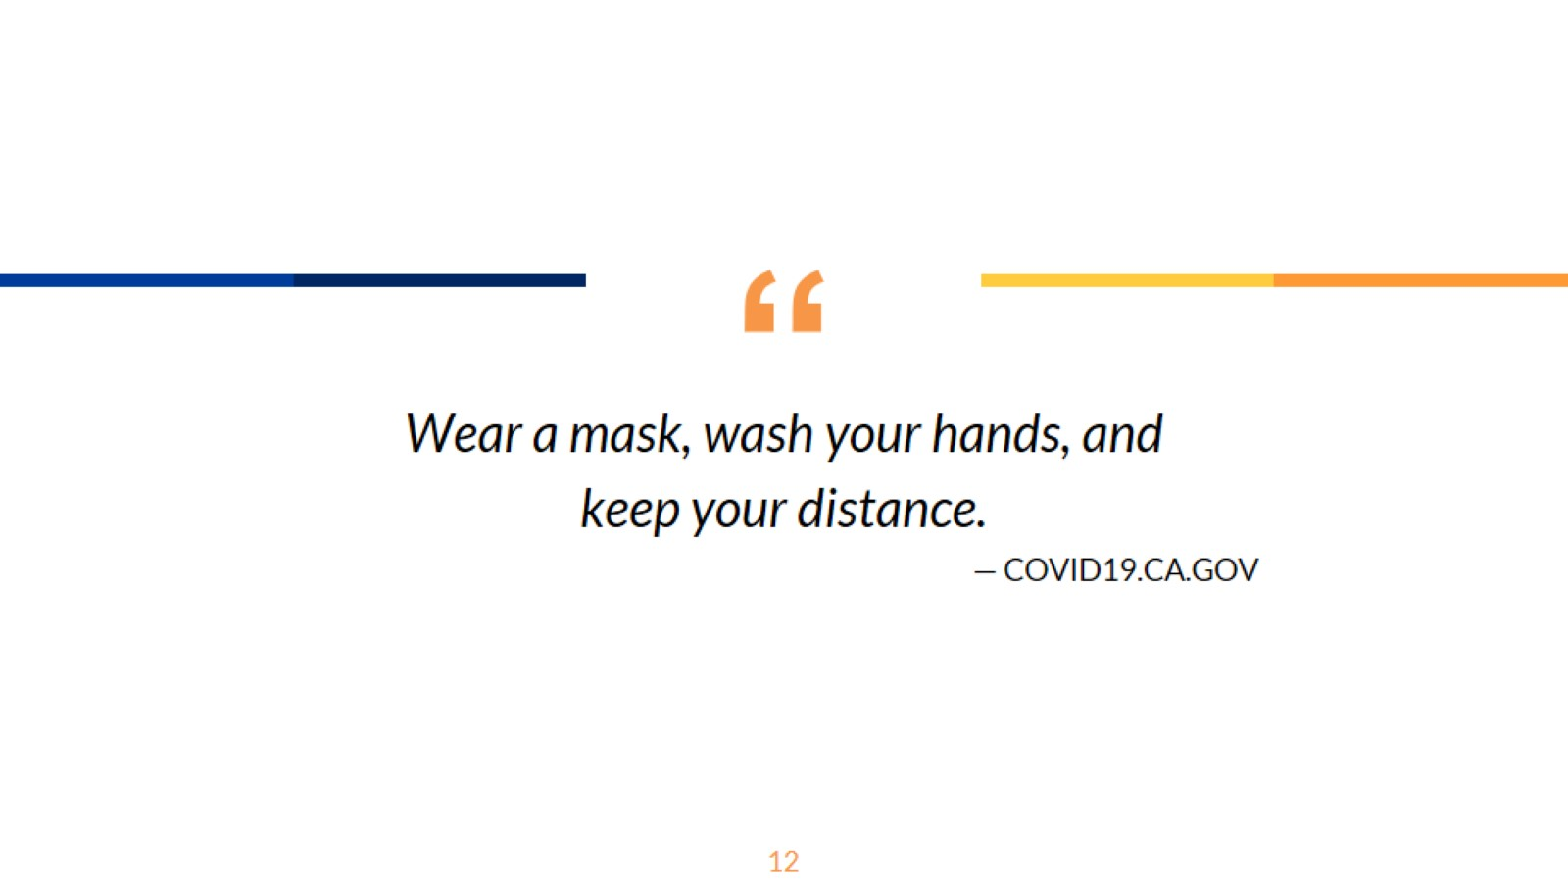
Notes:
There are three key steps that everyone should take to prevent exposure to the virus: wear a face covering, wash your hands, and keep your distance. We will talk more about each of these steps now.

Slide 13
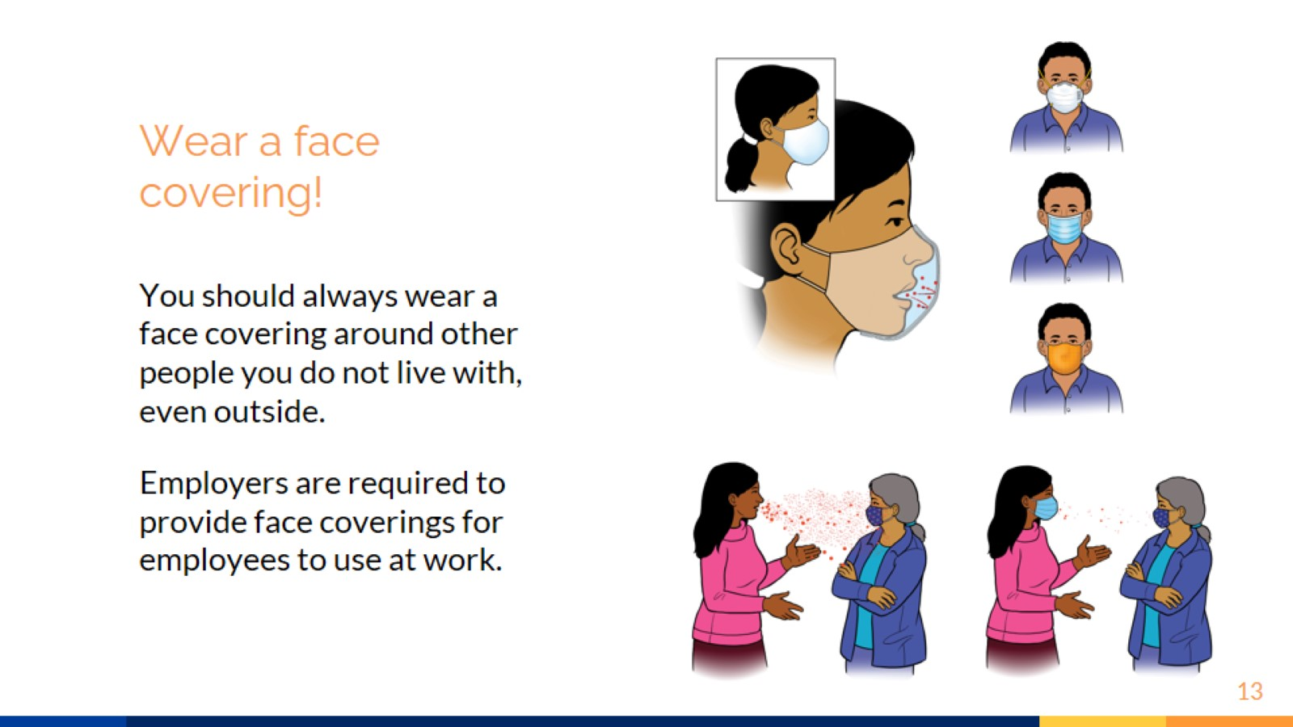
Wear a face covering!
Notes:
Wear a face covering!
People over the age of 2 wear face coverings around other people, this includes close family and friends that do not live in the same household.
In short, face coverings block most of the droplets we exhale when we breathe and talk and help to protect us from inhaling the droplets of others who may be infected.
There are different types of face coverings made with different types of fabrics or materials. Some are more effective at blocking droplets than others because of how close the fibers are woven together. The smaller the gap between the fiber of the material, the more effective the face covering will be. Here are some examples:
N-95 - These face coverings are known as "respirators". The spaces between the weft are so small that we cannot see them with the naked eye, and they are able to stop particles that can only be seen with a microscope. These face coverings protect us from breathing in most of the virus particles and are very good at blocking the particles we exhale. Due to the pandemic, these types of face coverings are difficult to find and it is recommended that they be reserved for healthcare workers, pesticide applicators, and those who are working outside during times of fire.
Surgical face covering - This face covering is less effective than the N95 at protecting us from inhaling particles, but they do help to block the big droplets we exhale and protect others. This type of face covering is disposable, so it is recommended that it be thrown away after one day of use.
Cloth face covering - Like the N95 and surgical face covering, the cloth face covering helps to protect others from our droplets in case we are sick and do not know it. These face coverings can be homemade from different materials, but experts recommend that they have at least three layers of material to better filter the particles. These should be washed after every use.
Remember, everyone should wear a face covering when in public unless they have breathing problems, are under the age of two, or can't remove the face covering without assistance.
Your employer is required to provide a face covering to you or reimburse you if you had to buy your own.

Slide 14
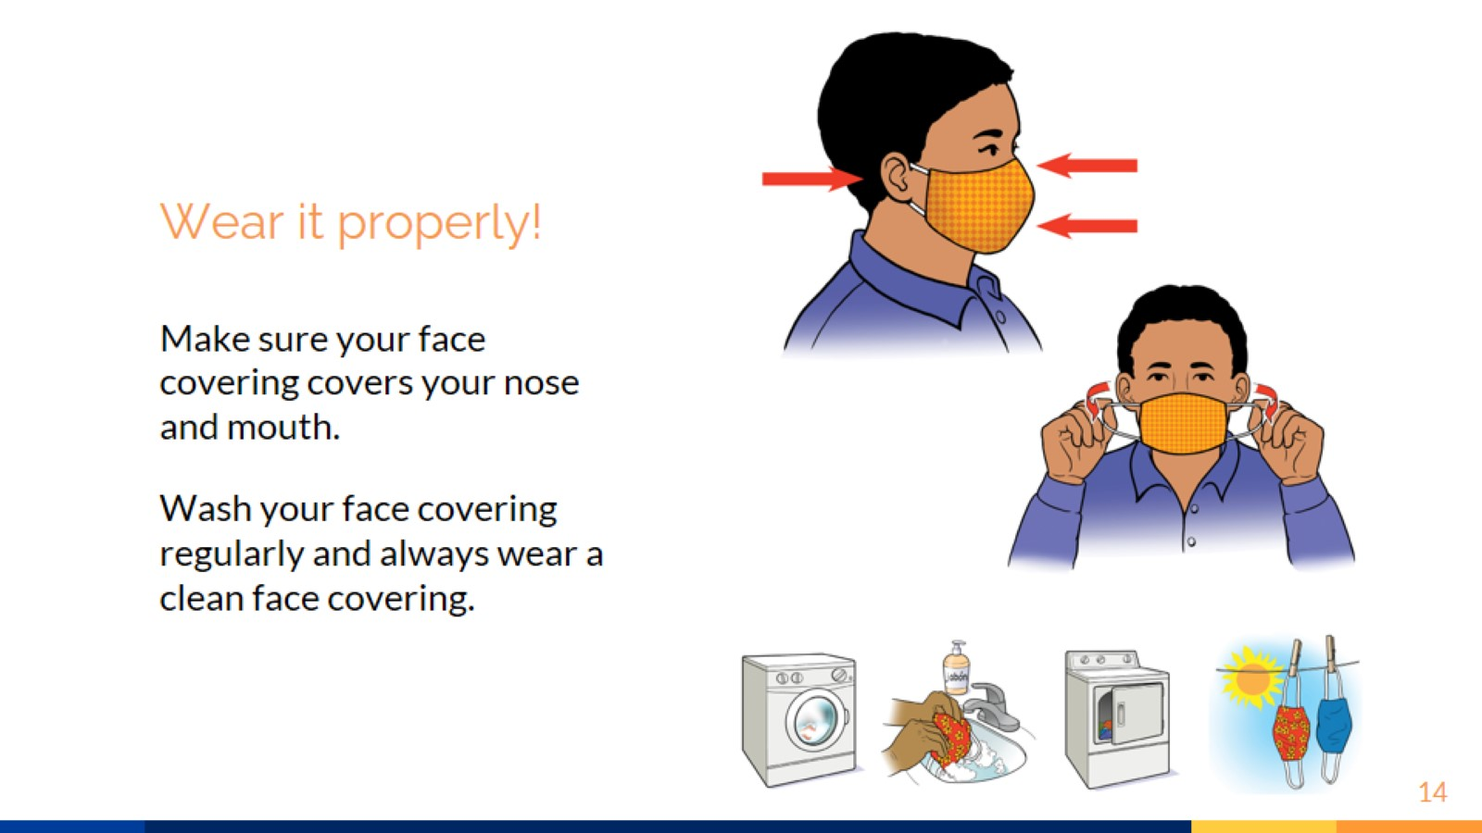
Wear it properly!
Notes:
How to Use a Cloth Face Covering:
Since most of us are using cloth face coverings, it is important to remember how to use it, remove it, and wash it properly. All of these steps are important in preventing the spread of the virus.
Be sure to choose a face covering size that covers your nose and mouth and fits snugly against the sides of your face.
If the face covering is loose, adjust the straps that secure the face covering behind the ears or behind your head.
If the face covering does not fit over your nose and mouth or reveals your nose or mouth when you speak, replace the face covering with a larger face covering. Make sure that it always covers your nose and mouth.
Keep more than one face covering with you so you can change it if it becomes dirty.
To remove the face covering:
Untie the strings or stretch the ear loops forward, making sure not to touch the outside of the face covering.
Fold it in half so that the outside is inside the fold.
If the face covering is visibly dirty or wet, put it in a plastic bag until you can wash it.
Avoid touching your eyes, nose, and mouth when removing the face covering, and wash your hands immediately after removing it.
Wash the face covering
You should wear a clean face covering everyday. This means you may need to wash face coverings multiple times a week.
To wash cloth face coverings in the washing machine:
Use regular detergent with hot water
To wash cloth face coverings by hand:
Wash your face covering with water and detergent or laundry soap.
Rinse well with clean water to remove detergent or soap.
Dry your face coverings completely
Dry your face covering in a warm or hot dryer or by hanging it up in direct sunlight. If you cannot hang it in direct sunlight, hang or lay it flat and let it dry completely.

Slide 15
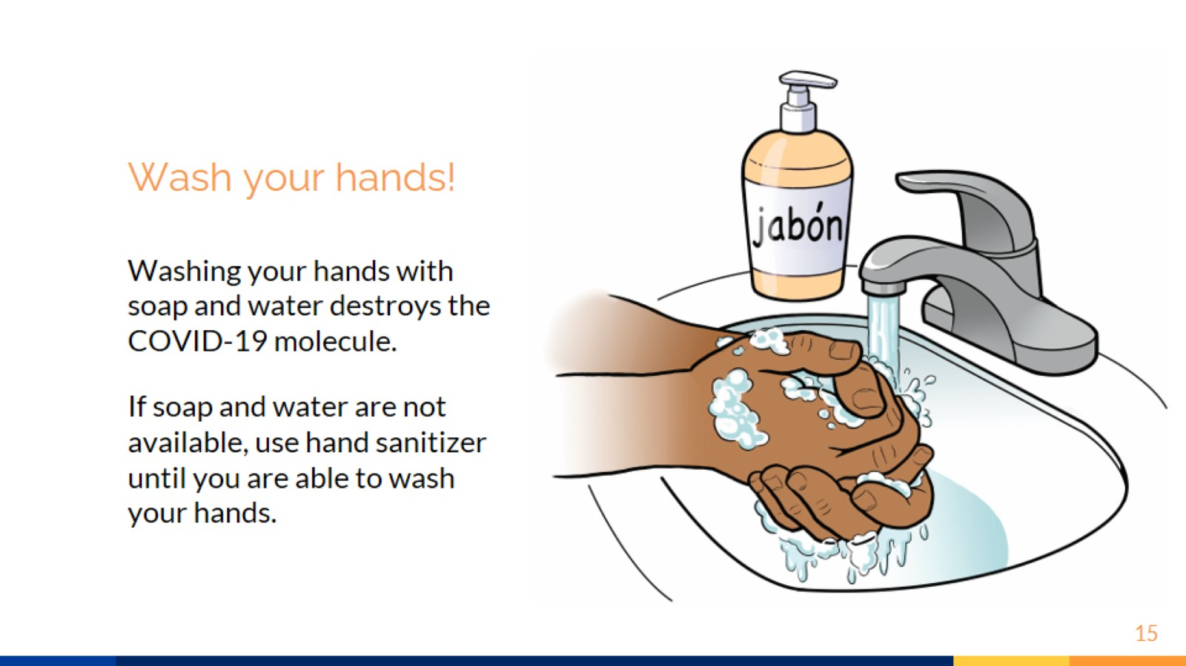
Wash your hands!
Notes:
Wash your hands!
Although it is more common for COVID-19 to spread through respiratory droplets, it can also spread through surfaces that have been contaminated with the virus. The virus can enter our body through our eyes, nose, and mouth when we touch these surfaces and then touch our face. This is why it is so important to wash your hands.
Some people do not believe in the importance of washing their hands. One of the questions we have heard is: If COVID-19 is so serious, how does it help to just wash your hands?
Even though it seems very simple, washing your hands with soap and water is the best way to eliminate or prevent the spread of germs and viruses. Remember the picture of the COVID-19 virus we saw earlier with the spiky crown? The COVID-19 virus has an outer layer that is made up of lipids, like what oil is made out of. As you know, if you get oil on your hands you can’t wash it off with water alone, but once you add soap, it starts to come off. That's because soap separates the lipids from each other. Because of this, soap is able to break down the outer layer of the COVID-19 molecule and destroy it, so it can no longer infect you.
Always follow these five steps:
Wet your hands with clean running water (warm or cold)
Soap up hands until there is lathering on the palm, behind the hands, between the fingers, and under the nails.
Scrub your hands for 20 seconds. It's like singing the “Happy Birthday” song from start to finish twice.
Rinse your hands well under clean running water.
Dry them with a clean towel or in the air.
If soap and water are not immediately available, you can use a hand sanitizer that contains at least 60% alcohol. But soap and water is always better because it not only destroys the virus, but also removes it from your hands.
Remember to avoid touching your eyes, nose and mouth if you have not washed your hands.

Slide 16
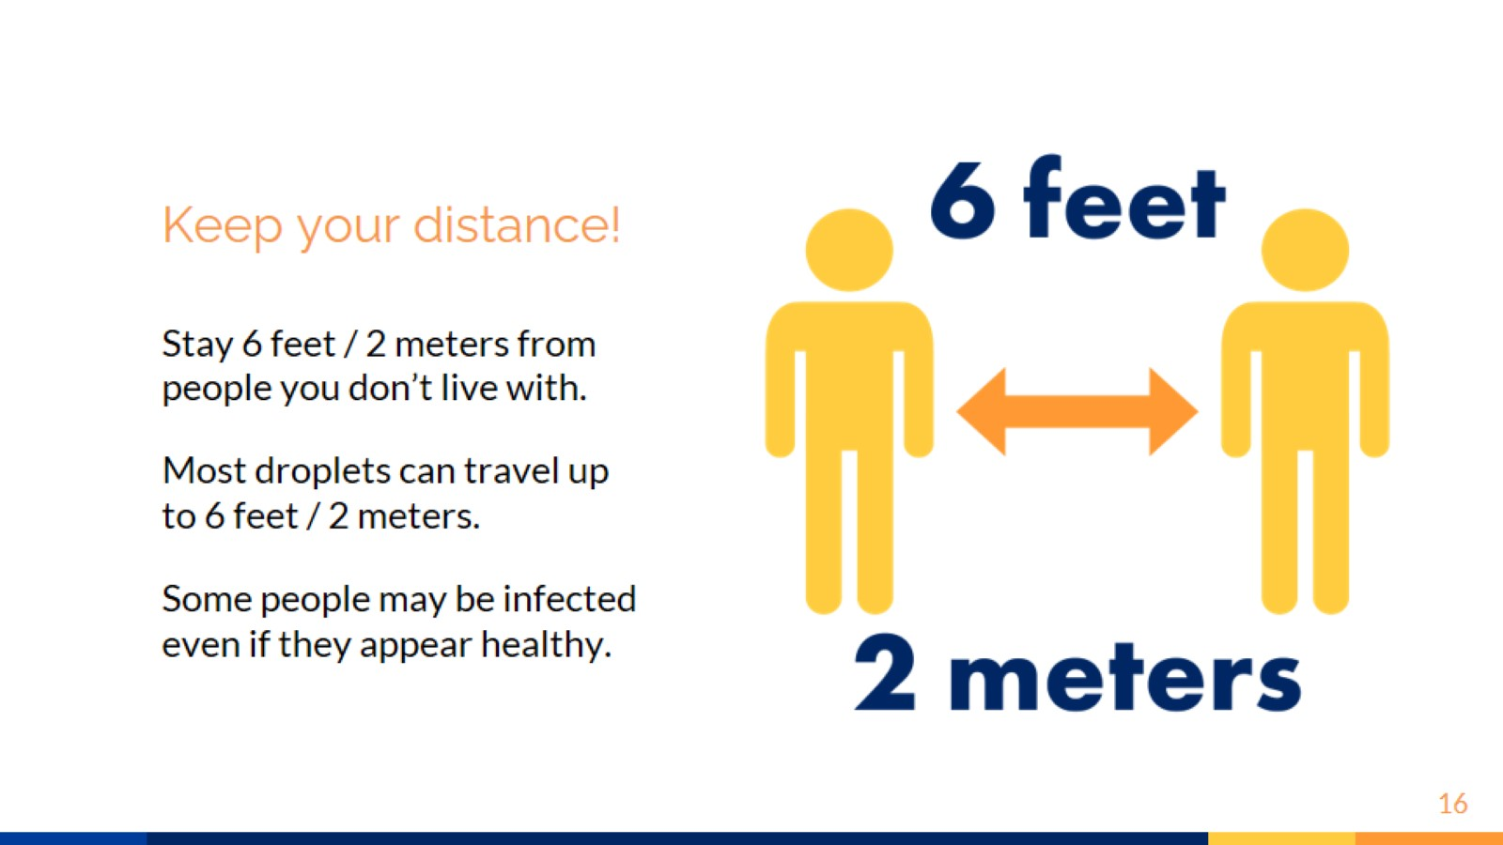
Keep your distance!
Notes:
Keep your distance!
You can reduce your exposure to the virus by staying 6 feet or 2 meters from people you do not live with.
The main reason for keeping your distance between people is that COVID-19 is transmitted through the droplets that we breathe out when we breathe, talk, cough, sneeze, sing, etc. When someone is infected, the droplets they exhale spread the virus to the area around them. These droplets can travel up to 6 feet/2 meters or more.
Remember, some people may be infected even though they appear healthy. These asymptomatic people could be someone at work, in the store, and even in the family. If they do not maintain at least 6 feet of distance, they can spread the virus to others through the droplets they exhale.

Slide 17
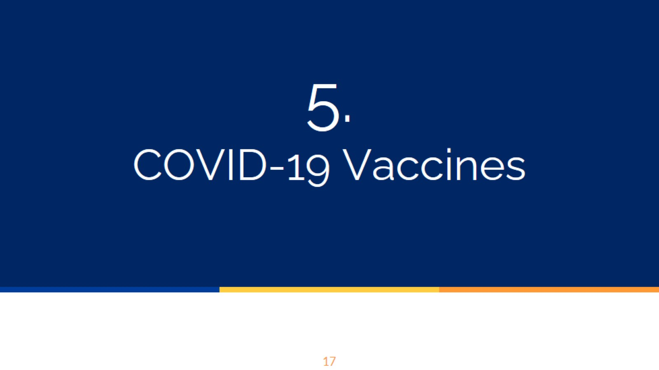
5.
COVID-19 Vaccines
Notes:
Lastly, we will talk about COVID-19 vaccines which are becoming more available.

Slide 18
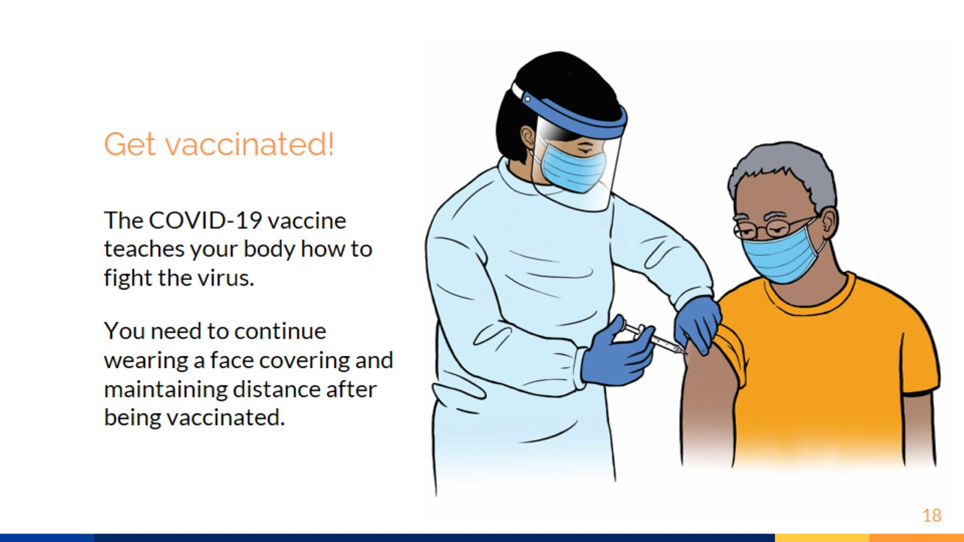
Get vaccinated!
Notes:
Get vaccinated!
In general, vaccines "teach" the body to defend itself by creating defenses against a virus. These defenses are like soldiers that your body creates that are ready for battle in case the virus enters your body.
The COVID-19 vaccine has been rigorously tested and is safe. Three vaccines have been authorized for COVID-19. Two require two doses (Pfizer and Moderna) and one requires a single dose (Johnson & Johnson). All three vaccines have been tested and are effective. After you receive the vaccine, you may experience mild side effects, like pain or swelling where the shot was given. Some people may also feel symptoms similar to COVID-19, like feeling tired, having a headache, or chills. But those symptoms are a signal that your immune system is reacting to the vaccine and preparing to defend itself from the virus. Side effects from the vaccine do not last long, usually less than 2 days, and are less severe than the actual disease. It is more common to experience side effects after the second shot, and people who are younger tend to have a bigger reaction to the vaccine than older people.
It is important to continue practicing all of the prevention strategies that we have discussed even after you receive the vaccine. It takes a few weeks after the second shot before the vaccine can actually protect you since your body needs time to build up its defenses. Also, not everyone has received the vaccine, and scientists are still learning about whether or not someone who has been vaccinated can still spread the virus and infect others. It is also not known yet for how long the vaccine will protect against the virus. This is why we should continue practicing the prevention strategies we have discussed, like wearing a face covering and maintaining distance from others, until we know more.

Slide 19

6.
Review

Slide 20
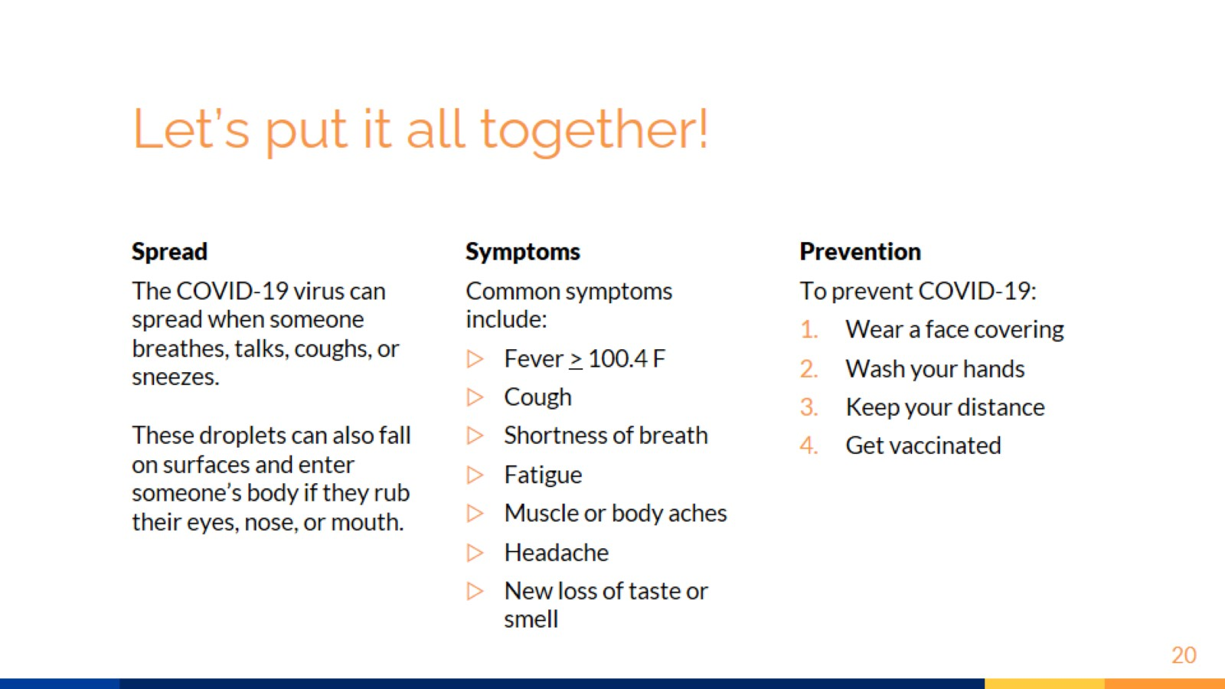
Let’s put it all together!

Slide 21
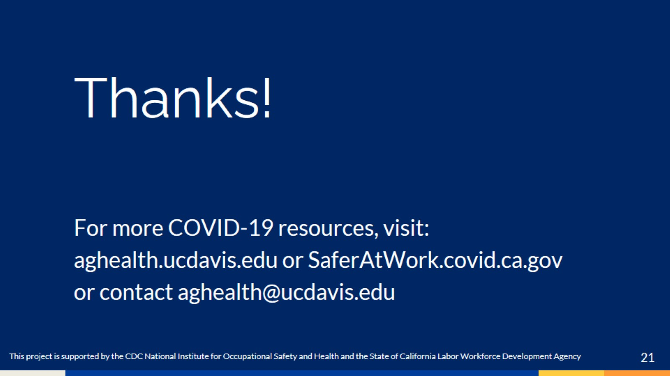
Thanks!

